Slide 1


Machine Learning Challenge
ALEXANDER PAK YU LAI (218401269)
HARRY WILLIAM LODGE (218241616)
VIET NAM NGUYEN (218459058)
JARROD KENG YEN YONG (218271795)

Slide 2

Introduction
Main observations from previous report:
Many pairs of variables have a strong positive correlation related to rain predictions
Humidity and pressure can help predict rain
Accuracy of 79% in model
Models used:
Classification: KNN, PCA, XGB, Naïve Bayes, Decision tree classification and Random forest
Regression: Linear and Logistical
Neural network

Slide 3
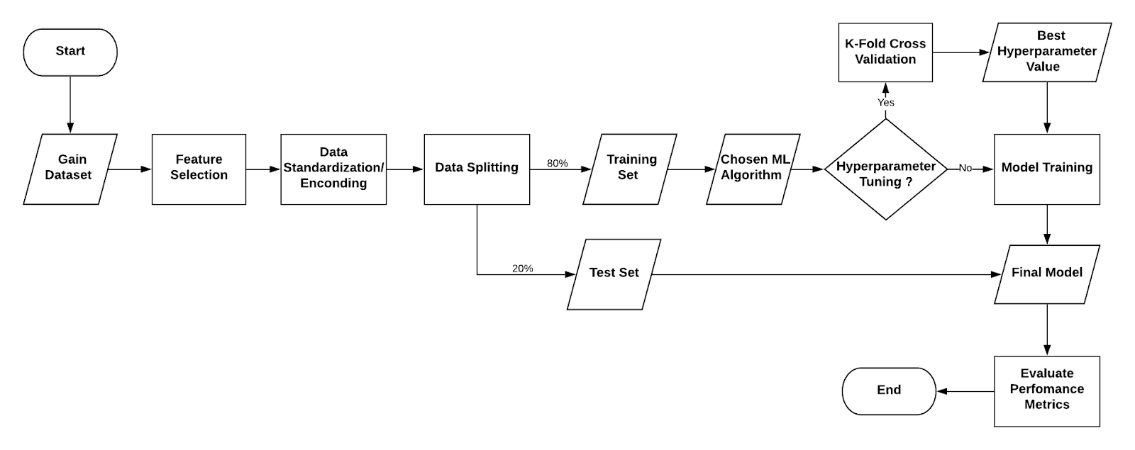
Machine Learning Flowchart

Slide 4

Classification Models

Slide 5
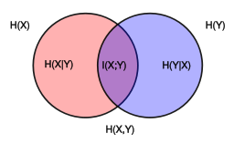
Feature Selection
Humidity3pm
Pressure9pm
Pressure3pm
Rainfall
WinGustSpeed

Slide 6
Naïve Bayes
Target variable was encoded into numerical values, "Yes" for 1 and "No" for 0
The precision and recall for class 0 were higher than class 1
Accuracy Score: 0.81
Be able to determine whether it will rain tomorrow in Australia

Slide 7
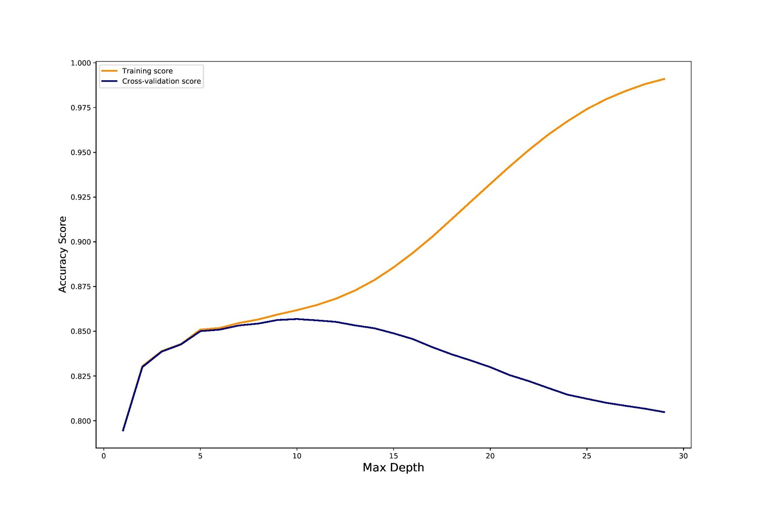
Decision Tree
Applying 10-fold cross validation on training set resulted in the best max_depth of 5
Accuracy score: 0.85
Performed well in predicting the status of tomorrow rain in Australia

Slide 8
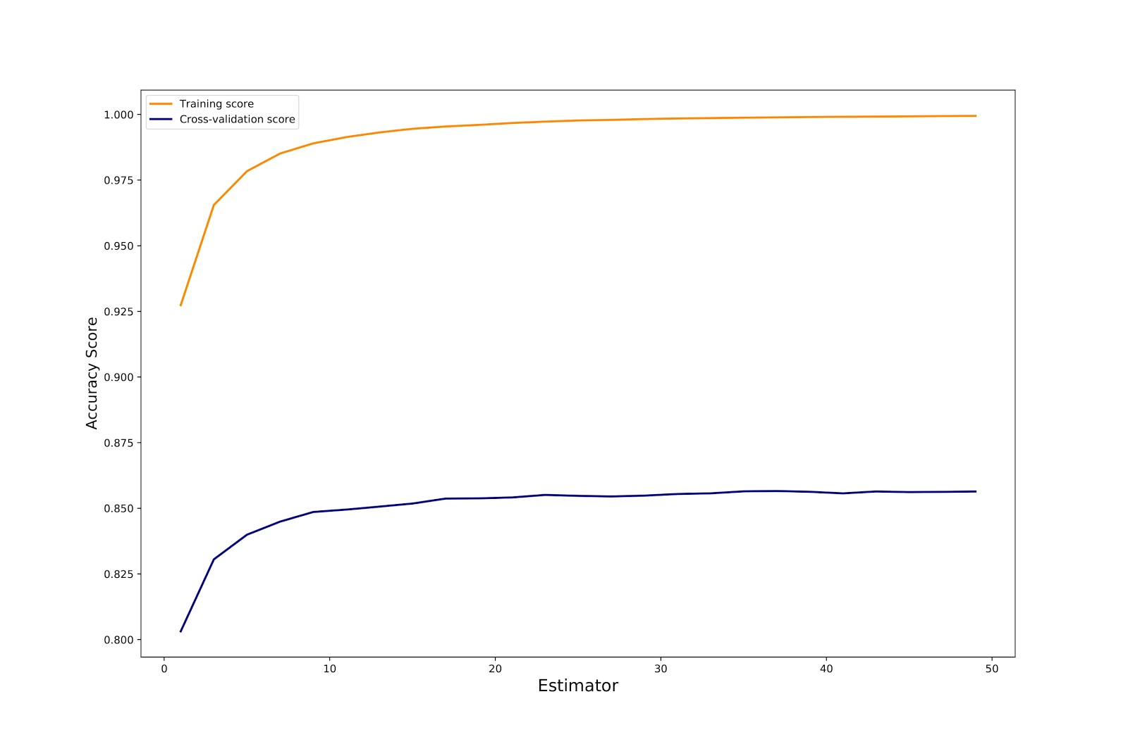
Random Forest
Exploiting 10-fold cross validation on training set led to the best number of ensemble of 3
Accuracy score: 0.83
Returned the potential of overfitting and less accurate prediction
Possibly quite accurate prediction on tomorrow rain in Australia

Slide 9
K-Nearest Neighbours
KNN chooses closest neighbours and based on this assigns a class
Predicts a Value for new observations
Rain Tomorrow was the target
Overall Accuracy 81%
The choice of K Values are crucial
Results show its practicality, but caution should be used

Slide 10
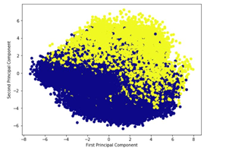
XGBoost
Popular algorithm in Structured and Tabula data
PCA Recommended to reduce dimension
Graph of Components show abundance of linear combinations
Train Test and XGBoost implementation
Scores show PCA usage
XGBoost showed models performance

Slide 11
Regression Model

Slide 12
Linear Regression
Entire dataset standardized to a range from 0 – 1
Highest correlation coefficient is around 0.37
Each feature and target calculated to see if it would fit the dataset
The model is underfitting and not able to predict tomorrows weather outcome.

Slide 13
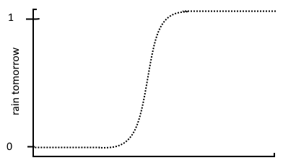
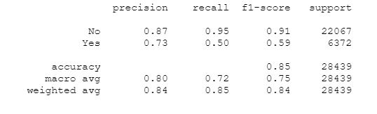
Logistic Regression
Date, location, wind dir and risk mm removed
Easy to implement
Shorter than neural network in prep time than neural network
Faster prediction time than neural network
High accuracy

Slide 14
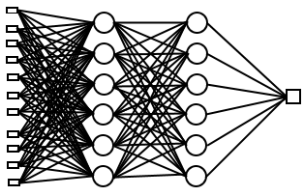
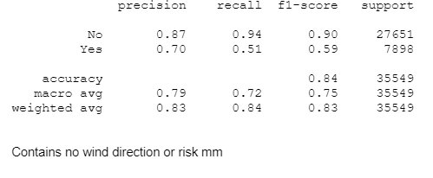
Neural Network
Only date, location and risk mm removed
Different data sets were used with different variables
Different amount of hidden layers tested with varying neuron counts
Time intensive with large networks
High accuracy

Slide 15
Conclusion
All above 80% accuracy
Classification <regression and neural networks
Near identical implementation
Best classification = decision tree
Best of regression and neural network=logistic regression

Slide 16
References
Wikipedia n.d., Mutual information, Wikipedia, The Free Encyclopedia, retrieved 19 May 2020, <https://en.wikipedia.org/wiki/Mutual_information>.

